Slide 1



Publishing and Consuming Government Linked Data on the Semantic Web
Ghislain Auguste Atemezing
Multimedia Department, Eurecom
Supervisor:
Dr. Raphaël Troncy, MM Department, Eurecom

Slide 2
Outline
Introduction
Research Questions
Contributions
Semantic publishing of geospatial data
Visualizations of Government Linked Data
Best Practices for metadata in vocabularies
Conclusion
Publications

Slide 3
Research Questions
How to efficiently represent and store geospatial data on the Web to ensure interoperable applications?
the publication of real datasets
the interlinking with other datasets having overlapping coverage
What are the best options for a user to discover, browse and interact with semantic content?
Can we propose a generic model for visualizing semantic content?
What are the mechanisms to help preserving structured data of a high quality on the Web?
How to improve reusing vocabularies for better interoperability
How to detect incompatibility between data and metadata
Notes:
The answers to these Use Cases need to do some screen scraping on different html pages of data portals where the applications are described, sometimes without many information nor description.

Slide 4
Part 1
Modeling, Interconnecting and
Generating Geodata on the Web

Slide 5
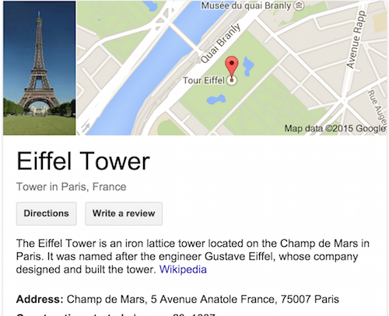

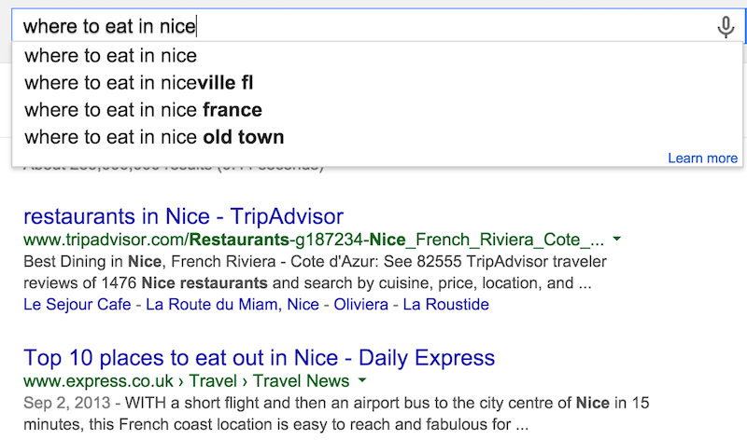

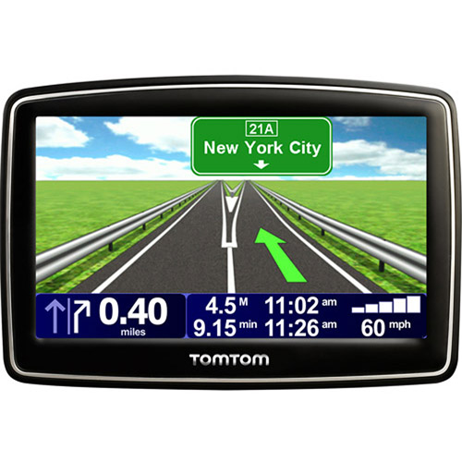
Geospatial data: why it matters?
“80% of needs for decisions from public authorities have a geospatial component”.
(Philippe Grelot, IGN-France)

Slide 6
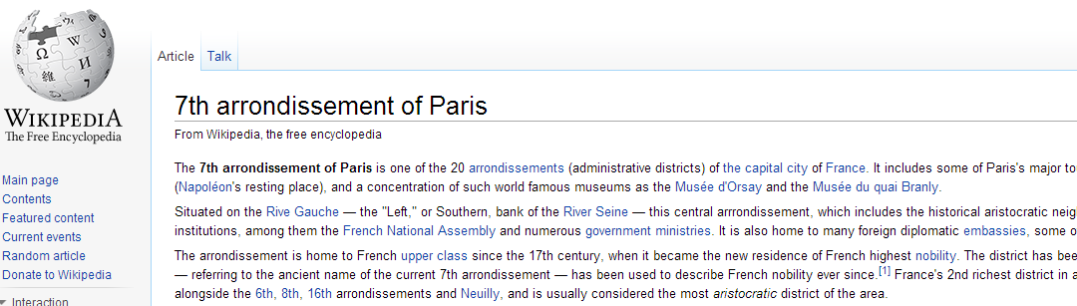
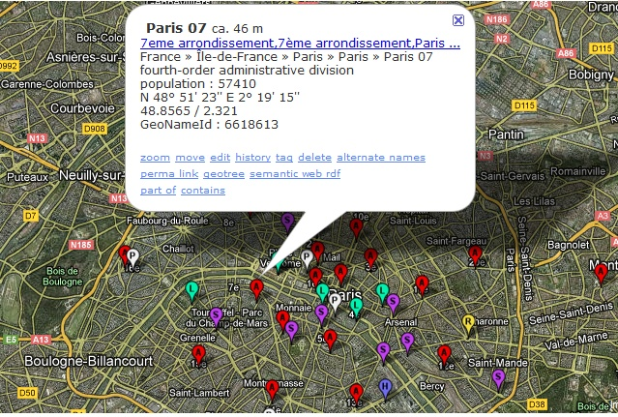
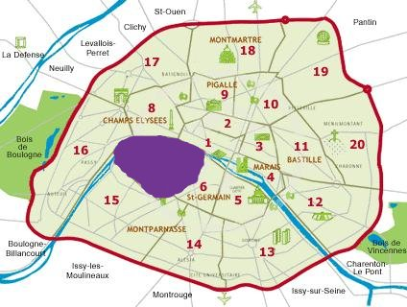
Scenario: 7th Arrondissement of Paris

Slide 7
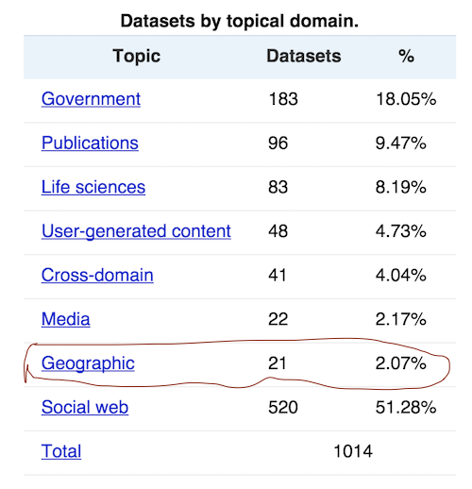
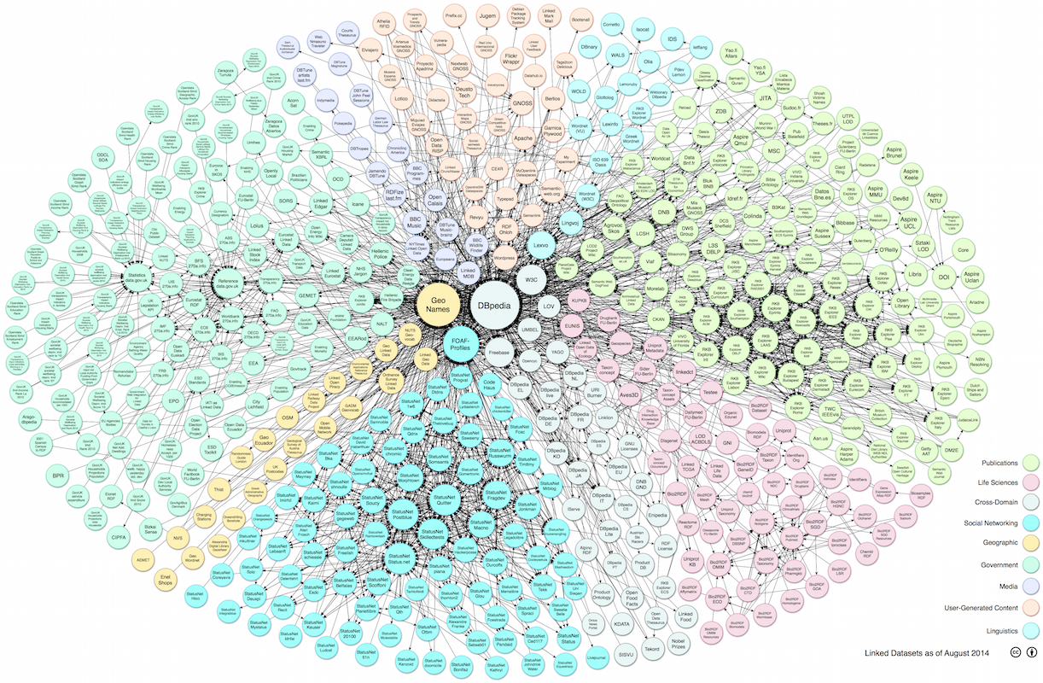
GeoData on the LOD Cloud
http://lod-cloud.net/versions/2014-08-30/
Linking Open Data cloud diagram 2014, by Max Schmachtenberg, Christian Bizer, Anja Jentzsch and Richard Cyganiak.
http://lod-cloud.net/

Slide 8
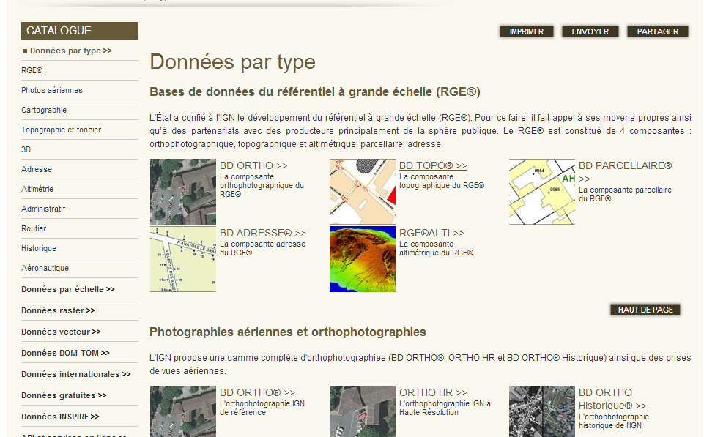
French IGN- Reference Geodata
« ..describes the French national territory and the occupation of its land, elaborates and updates perpetual inventory of the forest resources »
Different databases with overlapping information: BD ORTHO, BD PARCELLAIRE, POINT ADRESSE, BD ALTI 25m, BD TOPO; etc.
CRS: LAMBERT93 or RGF93
Q: ”Give me all the bridges in a radius of 2km from the "Eiffel Tower“?
A: Not straightforward
Notes:
Files available in SHP, pdf
Information overlap in different products, sometimes referring to the same « real world » concepts.

Slide 9
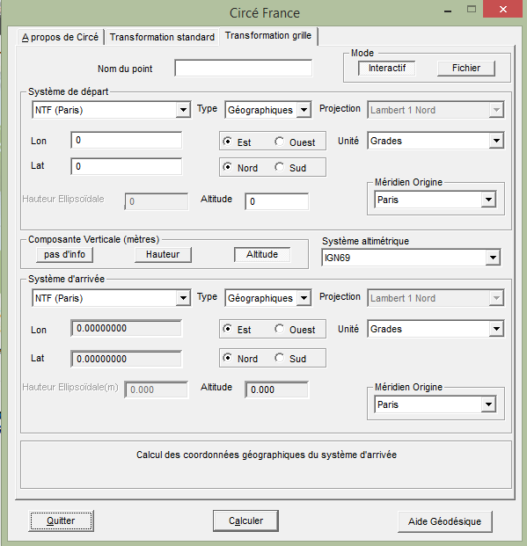
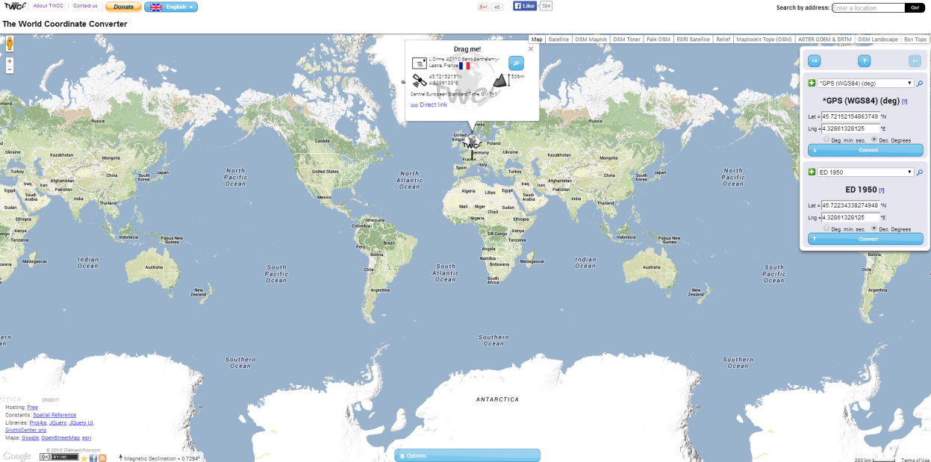
Current Tooling and Limitations
Circé: A Converter Software from IGN
Allows conversion between some France CRSs to WGS84
Closed Source, No open service
Existing Web tools (e.g., world coordinate converter)
No open service, closed source
Converting algorithms don’t usually map to any national mapping authority.
Contribution: a web based service to perform conversion between various CRSs.
The integration of such a converter can ease the process of the publishing different types of geometries on the web regardless of their Coordinates systems.

Slide 10
Developing a REST converter service
International Communication
Many regional's’ published data involve with local CRS
A medium
Interpret the coordinates between these CRSs
A Converter Service
Open services for community
RESTFul Web Service

Slide 11
Implementation - Evaluation
WGS 84 <–> Lambert 93 Algorithms
Conversion from WGS 84 to Lambert 93
Tools | Input |  |  | Output
 | Latitude (DD) | Longitude (DD) |  | X (m) |  | Y (m)
Geo Converter | 43.700594 | 7.277959 |  | 1044752.61 |  | 6298403.61
Circé |  |  |  | 1044752.20 |  | 6298404.17
twcc.free.fr |  |  |  | 1044752.61 |  | 6298403.61
Conversion from Lambert 93 to WGS 84
Tools | Input |  | Output
 | X (m) | Y (m) | Latitude (DD) |  | Longitude (DD)
Geo Converter | 1044752.61 | 6298403.61 | 43.700594 |  | 7.277959
Circé |  |  | 43.700589 |  | 7.277964
twcc.free.fr |  |  | 43.700594 |  | 7.277959

Slide 12
Implementation - Evaluation
WGS 84 <–> UTM Algorithms

Slide 13
Coordinate Reference Systems (CRS)
A representation of the locations of geographic features within a common geographic framework
Each CRS is defined by its measurement framework
Geographic: spherical coordinates (unit: decimal degrees)
Planimetric: 2D planar surface (unit: meters) + a map projection
Additional measurement properties: ellipsoid, datum, standard parallels, central meridians, etc.
Situation:
Several hundred Geographical Coordinate Systems (WGS84, ETRS89, etc.)
Several thousands Projected Coordinate Systems (UTM, Lambert93, etc.), http://resources.esri.com/help/9.3/arcgisserver/apis/rest/pcs.html

Slide 14
Application: Interlinking Geo Datasets
Use case: schools described as geographical objects in DBpedia (WGS84) and in data.gouv.fr (Lambert93)
LIMES (LInk discovery framework for MEtric Spaces) interlinking tool: https://github.com/aksw/limes
Test Cases
 | Test 1 | Test 2 | Test 3
Aggregate function | trigrams | trigrams | trigrams
Weight of Title | 0.3 | 0.3 | 0.3
Coordinate function | euclidean | euclidean | euclidean
Weight of Coordinate | 0.7 | 0.7 | 0.7
Matched Threshold | 0.95 | 0.9 | 0.93
Review Threshold | 0.9 | 0.8 | 0.88
No. Duplicates | 8 | 37 | 29
No. Review Duplicates | 29 | 900 | 40
1-n Results from Duplicate | No | Yes | No
1-n Results from Review | Yes | Yes | Yes
Correct matches | 36 | >36 | 63

Slide 15
Vocabularies for Modeling Features (1/2)
Authority list of terms (e.g. Foursquare)
Less structured
Represent categories of Points of Interest (POIs)
Typically, one type as an API answer
Need to express the semantics of the terms
SKOS Categories (e.g. GeoNames)
Classes are skos:conceptScheme
Codes are skos:Concept
Few classes … BUT many codes

Slide 16
Vocabularies for Modeling Features (2/2)
Domain specific ontologies
One ontology per subdomain (transport, administrative unit, hydrography, etc.)
Interconnected ontologies (by explicit semantic e.g. owl:imports)
UK (OS) – ES (GeoLinkedData)
Some richer ontologies created by (semi-)automatic tools / NLP
Deeper taxonomy to structure the ontology
LinkedGeoData: 16 high-level classes, 1294 classes
GeOnto: 2 high-level classes, 783 classes in total

Slide 17
Modeling Geometry
Point (lat/long)
WGS 84 vocabulary described by W3C
Rectangle (“bounding box”)
Geopolitical Vocabulary (FAO)
Points in a List
Sequence of points (LinkedGeoData)
An object is “formedBy” a ListOfPoints (GeoLinkedData.es)
Literals (GML datatype in RDF)
Ordnance Survey (UK)
More structured representation of complex geometry
NeoGeo Vocabulary (GeoVocamp), http://geovocab.org/
Notes:
Five approaches for modeling the Geometry: Point, Rectagne, Points in a List, Points in a group of RDF resources, Literals and more structured

Slide 18
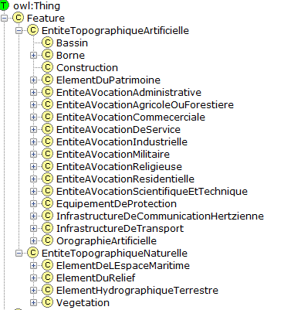
Reusing Existing Ontologies (GeOnto)
Ontology for geographic objects (POI)
Output of a French (ANR) research project
Obtained from NLP tools
Classes in French
rdfs:labels in FR & EN
No rdfs:comments
Few owl:ObjectProperty
783 classes
Overlap with other vocabs
Need for alignment

Slide 19
Alignment Methodology
Alignment of GeOnto with 4 ontologies and 2 more simple taxonomies
LGD, DBpedia, Schema.org, GeoNames
Foursquare, Google Places
Goal: finding owl:equivalentClass
Tool : Silk framework
Metrics : LevenshteinDistance, Jaro
Labels : @en des classes
Aggregation Function: Mean
Manual validation
For « rdfs:subClassOf »
Specific alignments with GeoNames codes

Slide 20
Alignment Process with GeoNames
geOnto:AGeoConcept a owl:Class; rdfs:label “a label”@en; rdfs:subClassOf gn:Feature; owl:equivalentClass [a owl:Restriction; owl:onProperty gn:featureCode; owl:hasValue gn:CODE. ]
Silk
Look for skos codes that matches GeOnto classes
Verify the links <70%
SPARL Endpoint
Use SPARQL « Construct » to generate a new graph.
Alignment File
Export the rdf file
Generate « sameAs » links

Slide 21
Results/Evaluation
High precisions > 80%
BUT P(Schema.org) = 50%.
Possible reasons: GeOnto entities are more specific to France
Fine grain details for entities in Schema.org
Vocab/taxonomies | #Classes | #Classes aligned
LGD | owl:Class: 1294 | 178
DBpedia | owl:Class: 366 | 42
Schema.org | owl:Class: 296 | 52
GeoNames | skos:Concept: 699 | 287
Foursquare | 359 | 46
Google Place | 126 | 41
bdtopo | owl:Class: 237 | 153

Slide 22
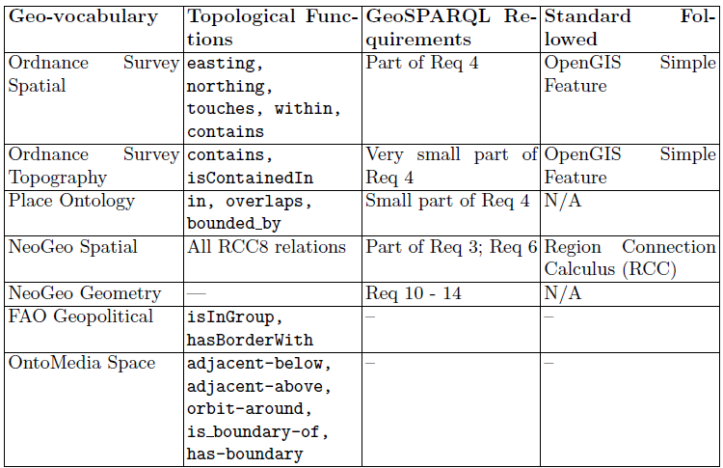
Topological Functions in GeoVocabs
NeoGeo (Spatial) and OS Spatial have integrated in their modeling partial
or full aspect of topological functions of GeoSPARQL.
Notes:
Comparison of GeoSPARQL wrt other vocabularies in topological functions or standards.
Here NeoGeo (Spatial and Geometry) and OS Spatial have integrated in their modeling partial or full aspect of topological functions of GeoSPARQL.

Slide 23
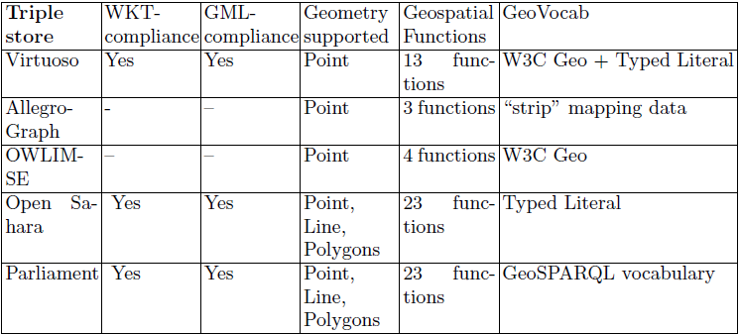

Triple Stores and geospatial indexing
Open Sahara, Parliament and Virtuoso are good choices
because they integrate many Geospatial Functions.
Open Sahara
Parliament
Virtuoso
Notes:
Triple stores survey with respect to geometry types supported and geospatial functions implemented.
Open Sahara, Parliament and Virtuoso are good choices because they integrate many Geospatial Functions.

Slide 24
CheckList for vocabulary modeling
Complex Geometry Coverage
Need to publish more data with complex geometries
Select suitable ontologies (e.g: NeoGeo) or GeoSPARQL
Features MUST be connected to Geometry
Sometimes it may requires two namespaces
Serialization and Triple Stores
Provide serialization in other GIS formats (GML, WKT, KML, etc.)
Store geodata in a triple store with many topological functions implemented (e.g: Open Sahara, Parliament, Virtuoso)
Literal vs Structured Representation
Use of structured representation for complex geometry
This covers some of the Use Cases at IGN
Notes:
GeoSPARQL needs to be published with (de)-referenceable URIs?! We want to have GeoSPARQL in the LOV catalog.

Slide 25
Coordinate Reference Systems (CRS)
A representation of the locations of geographic features within a common geographic framework
Each CRS is defined by its measurement framework
Geographic: spherical coordinates (unit: decimal degrees)
Planimetric: 2D planar surface (unit: meters) + a map projection
Additional measurement properties: ellipsoid, datum, standard parallels, central meridians, etc.
Situation:
Several hundred Geographical Coordinate Systems (WGS84, ETRS89, etc.)
Several thousands Projected Coordinate Systems (UTM, Lambert93, etc.), http://resources.esri.com/help/9.3/arcgisserver/apis/rest/pcs.html

Slide 26
Implementation
WGS84 - Lambert93
From WGS84 to Lambert93: Isometric Latitude calculation algorithm
From Lambert93 to WGS84: reverse Isometric Latitude calculation
WGS84 - UTM
UTM: http://en.wikipedia.org/wiki/Universal_Transverse_Mercator_coordinate_system
RGF 93 and WGS 84 using the same ellipsoid (GRS 80)
REST service being deployed
Source code: https://github.com/vienlam/Geo

Slide 27
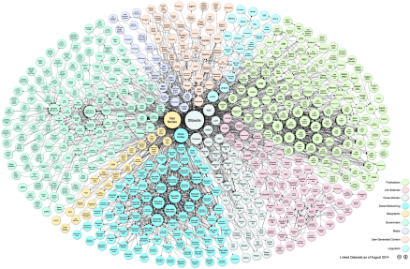
Geodata Publishing Workflow
GEOData publication process: tools and resources required
Adapted from (Scharffe, 2013)
L(O)D RDF
Data linking
RDFS/OWL ontologies
SW RDF
Vocabulary for geographic feature types
Mapping
RDF 2 RDF
Vocabulary for geometries
Raw RDF
CRS registry
Geo 2 RDF
Vocabulary selection
Vocabulary search
Existing vocabularies
Data sources
Spatial RDB
GML
SHP
…

Slide 28
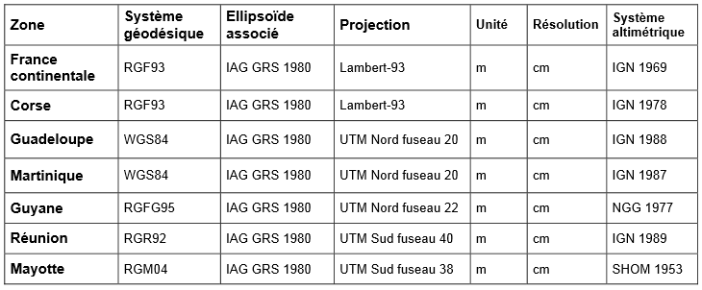
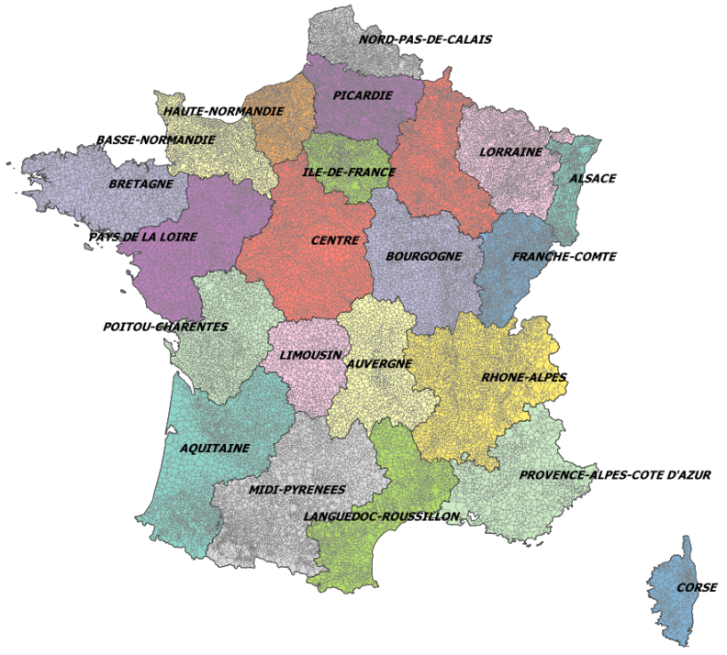
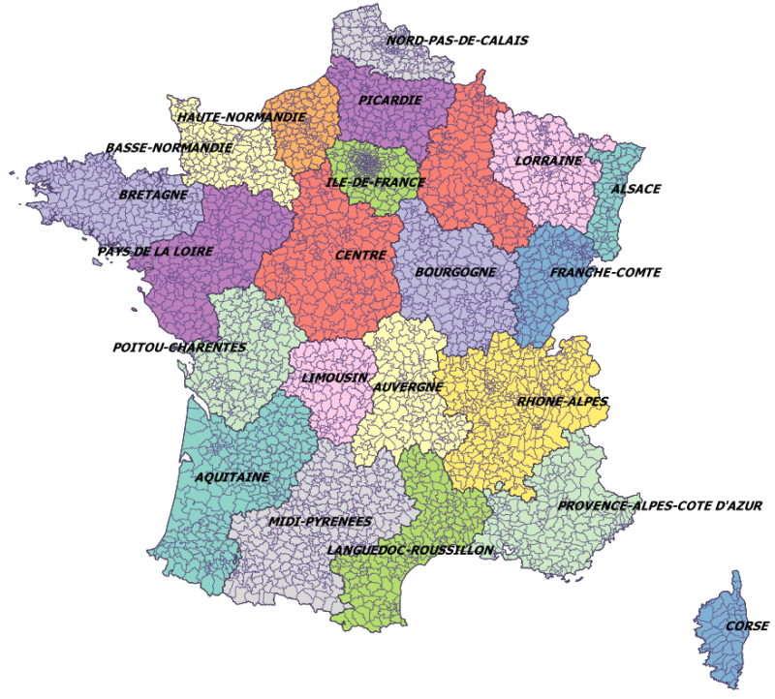
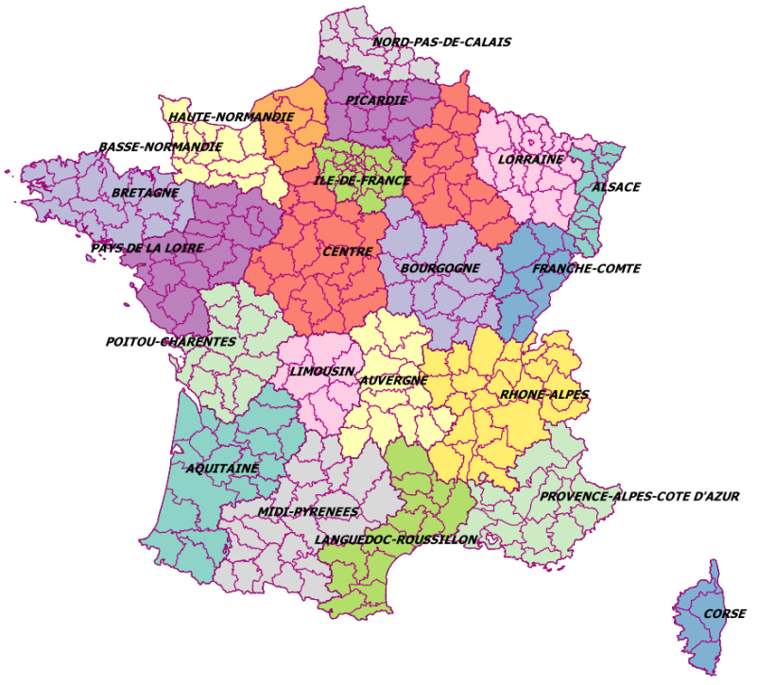
Vocabularies
GEOFLA® Dataset on French administrative units
Geofla metadata on CRS
http://professionnels.ign.fr/sites/default/files/DC_GEOFLA_1-1.pdf
Open Licence

Slide 29
Our Goal
Taking advantage of existing geographic data sources on the Web
- To geo-reference other resources: provide URIs for identifying geographic resources
- To contribute to better data linking results: provide detailed and precise geometries, spatial properties

Slide 30
Vocabulary for geometry
Requirements for describing geometries
(Atemezing and Troncy, 2012)
Dissociating features and their geometries
Representing structured geometries (à la NeoGeo)
Associating geometries to any type of things (not only Feature)
Associating geometries to any Coordinates Reference System

Slide 31
Vocabulary for geometry
Reusing Existing vocabularies?
W3C Basic Geo Vocabulary
GeoRSS
GeoSPARQL (Simple Features)
NeoGeo (geovocab)
Limites:
Not enough geometry types
Geometry represented only by literals
Restricted to WGS84 CRS
Domain of « hasGeometry » = Feature

Slide 32
Vocabulary for geometry
Reusing Existing vocabularies
To be extended with:
Structured geometries
Keep compatibility with GeoSparql (wktLiteral)
A property for associating anything to a geometry
A property for associating geometries to one given CRS
W3C Basic Geo Vocabulary
GeoRSS
GeoSPARQL (Simple Features)
NeoGeo (geovocab)
Limites:
Not enough geometry types
Geometry represented only by literals
Restricted to WGS84 CRS
Domain of « hasGeometry » = Feature

Slide 33
Vocabulary for geometry
Extending geosparql vocabulary
Creating subclasses of GeoSparql classes when needed
@prefix ngeo: <http://geovocab.org/geometry#>.
@prefix sf: <http://www.opengis.net/ont/sf#>.
[…]
geom:Geometry a owl:Class;
rdfs:comment "Primitive géométrique non instanciable, racine de l'ontologie des primitives géométriques. Une géométrie est associée à un système de coordonnées et un seul."@fr;
rdfs:label "Géométrie"@fr, "Geometry"@en;
owl:equivalentClass [ a owl:Restriction;
owl:onClass ignf:CoordinatesSystem;
owl:onProperty geom:crs;
owl:qualifiedCardinality "1"^^xsd:nonNegativeInteger];
rdfs:subClassOf ngeo:Geometry;
rdfs:subClassOf sf:Geometry.

Slide 34
Associating CRS to geometries
Requirements for CRS
Identified by dereferenceable URI
Identified by intuitive names
All French CRS (even deprecated CRS like “Lambert 1”, defined by IGNF authority)
Identifying and describing CRS on the Web
Existing solutions
OGC
http://www.epsg-registry.org
http://www.crs-geo.eu
http://spatialrefence.org
IGNF registry

Slide 35
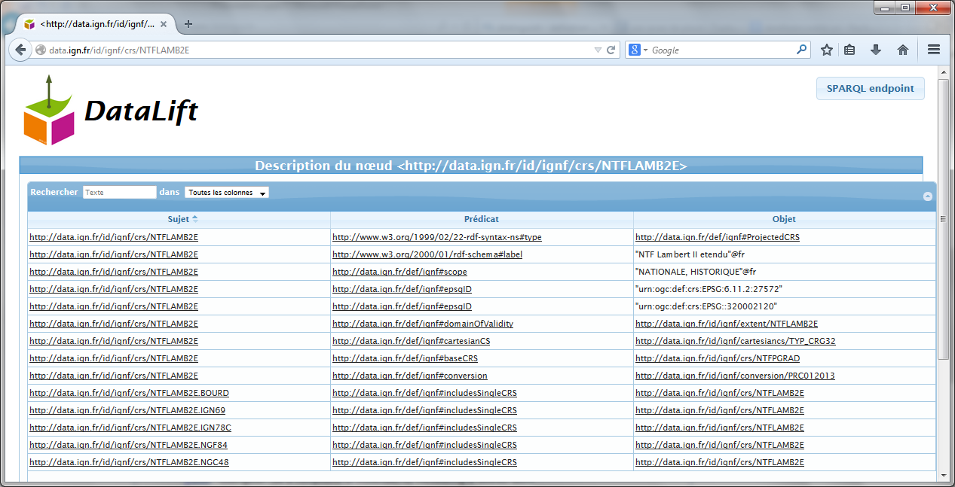
Associating CRS to geometries
A vocabulary for describing CRS
Subset of ISO 19111 model
Available at http://data.ign.fr/def/ignf
A dataset of French CRS
Converted from XML data published by IGN France to RDF with Datalift
Eg: “Lambert 2 étendu” http://data.ign.fr/id/ignf/crs/NTFLAMB2E

Slide 36
Vocabulary for geometry
→ Adding properties and restrictions for structured geometries
geom:Point a owl:Class;
rdfs:label "Point"@en, "Point"@fr;
rdfs:subClassOf geom:Geometry;
rdfs:subClassOf sf:Point;
owl:equivalentClass [ a owl:Class ;
owl:intersectionOf (
[ a owl:Restriction;
owl:onDataRange xsd:double;
owl:onProperty geom:coordY;
owl:qualifiedCardinality 1"^^xsd:nonNegativeInteger ]
[ a owl:Restriction;
owl:onDataRange xsd:double;
owl:onProperty geom:coordX;
owl:qualifiedCardinality "1"^^xsd:nonNegativeInteger]
[ a owl:Restriction;
owl:onDataRange xsd:double;
owl:onProperty geom:coordZ;
owl:maxQualifiedCardinality "1"^^xsd:nonNegativeInteger]
[…] )].

Slide 37
Vocabulary for geometry
→ Defining linestrings as ordered lists of points
→ Defining linear rings as ordered and circular lists of points
geom:LineString a owl:Class;
rdfs:label "Line string"@en, "Polyligne"@fr;
rdfs:subClassOf geom:Curve;
rdfs:subClassOf [
a owl:Restriction; owl:onClass geom:PointsList; owl:onProperty geom:points; owl:qualifiedCardinality "1"^^xsd:nonNegativeInteger ];
rdfs:subClassOf sf:LineString.
geom:PointsList a owl:Class;
rdfs:comment "Ordered list of points."@en;
rdfs:label "List of points"@en,"Liste de points"@fr;
rdfs:subClassOf rdf:List;
rdfs:subClassOf [
a owl:Restriction;
owl:allValuesFrom geom:Point;
owl:onProperty rdf:first].
9
1
8
2
7
3
6
4
5
Different interpretations of the same list of points may lead to different linestrings

Slide 38

Publishing GEOFLA Dataset
LIMES : labels
105 correct matches
14 communes, 75 departments and 16 regions
LIMES: labels of communes
23252 links created
13435 missing communes
NUTS
SILK: INSEE code and labels of departments
93 correct matches
3 missing departments
DBpedia FR
INSEE
L(O)D RDF
GADM
Data linking
LIMES: labels
70 correct matches
10 communes, 51 departments, 9 regions
SW RDF
CRS Dataset
http://data.ign.fr/def/geofla
Mapping
RDF 2 RDF
Raw RDF
http://data.ign.fr/def/geometrie
xxx 2 RDF
Geofla® shapefiles

Slide 39
Publishing GEOFLA Dataset
rgeofla:commune/65032 a geofla:Commune
rdfs:label “ ARRENS-MARSOUS ” @fr
geom:geometry rgeofla:commune/Multipolygon _6182
geofa:siegeDuChefLieu rgeofla:commune/PointChf_65032
owl:sameAs <http://id/insee.fr/geo/commune/65032>.
rgeofla:commune/Multipolygon _6182 a geom:MultiPolygon
gsp:asWKT “ <http://data.ign.fr/id/crs/WGS84GDD> MULTIPOLYGON (((-0.24335582250116848 42.82314107702203 …..))) ” gsp:wktLiteral
geom:crs <http://data.ign.fr/id/crs/WGS84GDD>
…
rgeofla:commune/PointChf_65032 a geom:Point
gsp:asWKT “ <http://data.ign.fr/id/crs/RGF93LAMB93> POINT(433500 6206700) ” gsp:wktLiteral
geom:crs <http:// data.ign.fr/id/crs/RGF93LAMB93 >
geom:coordX “ 433500 ” xsd:double
geom:coordY “ 6206700 ”xsd:double
…

Slide 40
Converting and linking French Gazetteer
LinkedGeoData:
lgdo:Amenity
5 543 000 triples
LIMES: geometries, threshold 0,9
654 links created
L(O)D RDF
103 413 features
Data linking
SW RDF
CRS Dataset
http://data.ign.fr/def/topo
Mapping
RDF 2 RDF
Raw RDF
http://data.ign.fr/def/geometrie
xxx 2 RDF
Geofla® shapefiles

Slide 41
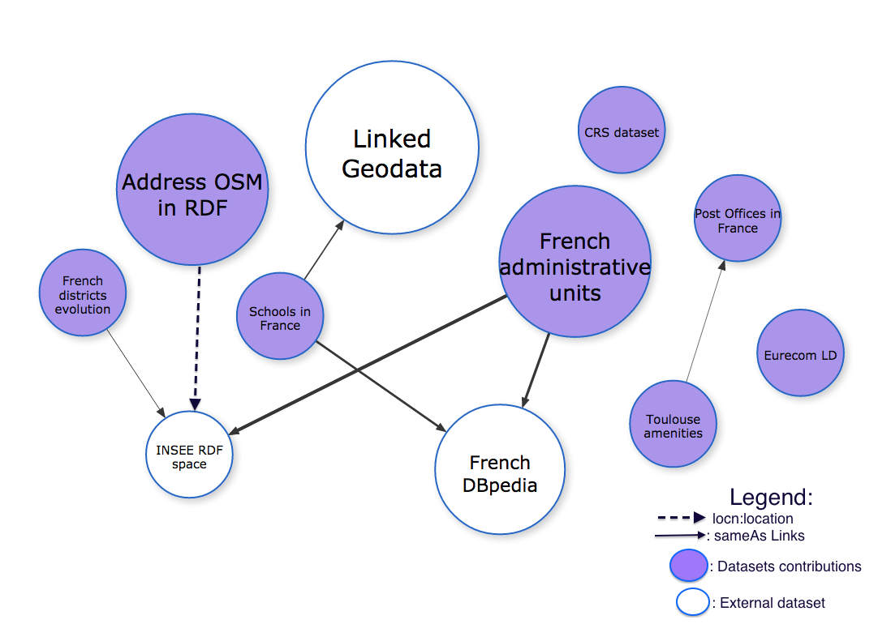
Contribution to the LOD Cloud

Slide 42
Part Two
Generating Visualizations
For Linked Data

Slide 43
Why visualizations matter?
Many structured datasets are now available on the Web (e.g., 3 billions of Triples for Dbpedia 2014 release)
RDF is not what we show to end-users
InfoVis community has mature tools and studies on visualizing information.
Triples are good, but need to be “beautiful” for end-users.
In the era of “structured big data”, we also need tools for Web – based visual analysis and reporting.
Notes:
The answers to these Use Cases need to do some screen scraping on different html pages of data portals where the applications are described, sometimes without many information nor description.

Slide 44
Applications
Goal: Describe common patterns of visualization applications from Government Data Portals to make them reusable and interoperable
The importance of visualization in Linked Data
Show some use cases
Survey of Apps in Government Data Portals
On Reusable Applications
A survey of visualization tools used by Open Data Apps
Search for common and reusable features
DVIA: a vocabulary for Describing VIsualization Apps
Conclusion and Future Work

Slide 45
An application is worth a billion triples
Use case 1: “Give me applications in Government Linked Data platforms in the domain of taxes”
Use case 2: “Find me apps running on Android in data.uk.gov for finding the nearest drugstores”
Use case 3: “How many free or inexpensive applications are available using US datasets in Health and Insurance domains”
Notes:
The answers to these Use Cases need to do some screen scraping on different html pages of data portals where the applications are described, sometimes without many information nor description.

Slide 46
Visualization Apps in Government Portals
Study of applications consuming Open Data
Countries: UK (7), USA (3) and France (3)
Number of applications: (13)
Domain: education, health, transport, government, city, housing, criminality, foreign aid
Classification dimensions
Platform (web, mobile), data sources, which views are available (maps, charts, timeline, etc.)
URL policy for identifying data objects
License for the application / for the data
Commercial / non-commercial

Slide 47
Visualization Apps in Government Portals
Applications | Domain | Country | Use RDF data | Platform | Views
UK Crime | Criminality | UK | no | Web | Map, chart, pie chart, tabular
UK Pharmacy | Drugstore | UK | no | iPhone, Android | Map
Numberhood | Local area dynamics | UK | no | IPhone | chart, histogram, tabular views
BUSit London | Transport | UK | no | Web, Mobile | Map
UK School Finder | Education | UK | no | Web | Map, tabular, histogram
Where-can-I-Live | Housing | UK | no | Web | Map, chart
Open Data Communities | Local government | UK | yes | Web | Graph, Map
FlyOnTime | Transport | US | no | Web | Pie chart, histogram, tabular
White House Visitor Search | Government | US | yes | Web | Bar chart, pie chart, tabular
Comparing US-USAID vs UK-DFID Global Foreign Aid | Foreign Aid | US | yes | Web | Map, pie chart
Fourmisante | Health | France | no | Web | Map
MaVilleVuDuCiel | City | France | no | Web | Map, facet views
Home'n'Go | Housing | France | no | Web | Map, tabular views

Slide 48
Linked Data Application Categories (*)
Generic applications
Used to browse any RDF graph (e.g: Tabulator, OpenLink Data Explorer)
Vocabulary-specific applications
Built around particular vocabularies (e.g.: FaceBook Social Graph API, IsaViz, CubeViz)
Data-specific applications (mashups)
Built around particular datasets (e.g. Where does my money go, IOGDS: International Open Government Dataset Search)
(*) Classification according to:Jeni Tennison : http://www.jenitennison.com/blog/node/126

Slide 49
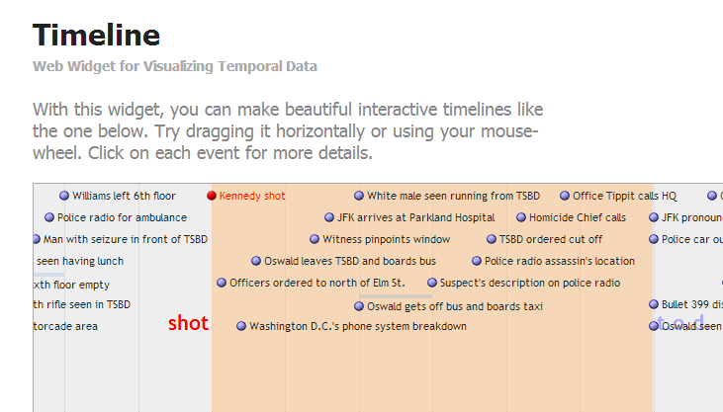
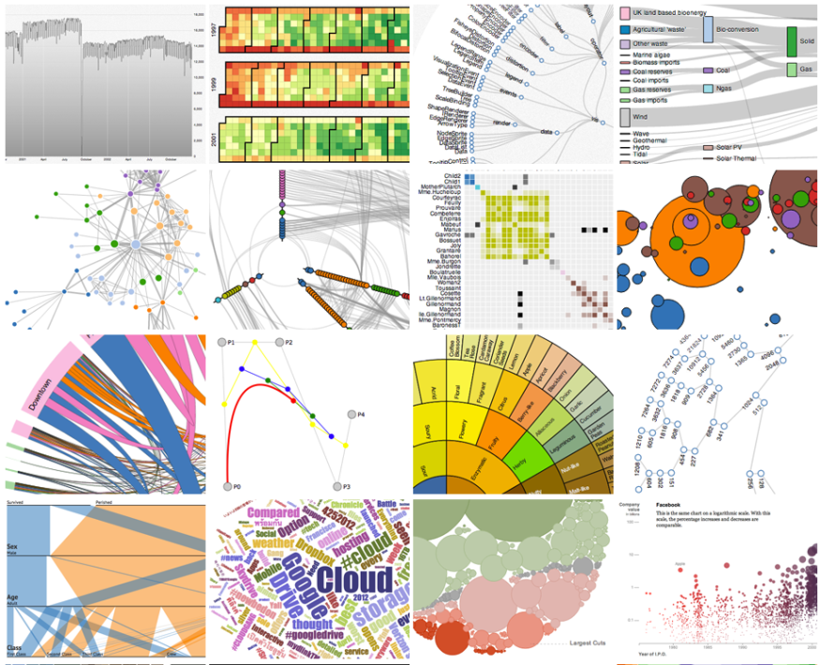
Relevant Features in Visualization Tools
Data format given as input (csv, xml, shp, rdf, etc.)
Data access (API, dump, etc.)
Language code
Type of view
External Libraries
License
Metadata: author, organization
Notes:
Importance of each feature:
* Data formats: the type of the format could lead to the decision of creation a converter layer before the visualization layer.
Data access: defines how to get the data, such as simple dump, API, SPARQL endpoint
Language code: this helps deciding also for the integration of tool.
Type of view is essential depending on the type of the data to display. E.g: if the tool does not provide timeline view, it could be difficult to want to create a visualization making use of timeline.
* External libraries are useful for integration compatibility.
* License for reusability of the tool
* Author/creator for metadata mention of the owner or the tool

Slide 50
Classes of Visualization Tools
2 categories of visualization tools
Those operating over RDF data
Those operating over structured data
5 features to assess a visualization tool
Usability
Visualization capabilities (type of views)
Data accessibility (API, endpoint, dump)
Deployment
Extensibility

Slide 51
Visual Tools with API access
Tools | Data formats | Type of Views | License
Choosel | xls, csv | Text, Map, BarChart | Open
Many Eyes | xls, plain text, html | Charts, trees, graphs, maps | IBM
D3.js | csv, svg, GeoJson | Charts, trees, graphs, maps | Open
Google Visualization API | Json, csv | Many charts, control and dashboard | Open
Data Publica | DSPL | Map, graph, histogram, table | Proprietary
GeoAPI | gml, kml, gpx | Map views | Free for non commercial use

Slide 52
Visual Tools using RDF
Tools | Type of views | License | Data Access
Fresnel | Properties, labels | Open | -
Spark | Charts, simple table | Open | SPARQL
LDA | - | Open | SPARQL
SemWeb Import | Graph, node views | CECILL-B | SPARQL CONSTRUCT
Facet Spatial Semantic Browsing Widgets | Map, facet views | Open | SPARQL
Sgvizler | Map, charts, timeline, sparkline | Open | SPARQL SELECT
Visual Box | Map, charts, timeline, graphs | Open | SPARQL SELECT
Map4rdf | Map, facet views | Open | SPARQL

Slide 53
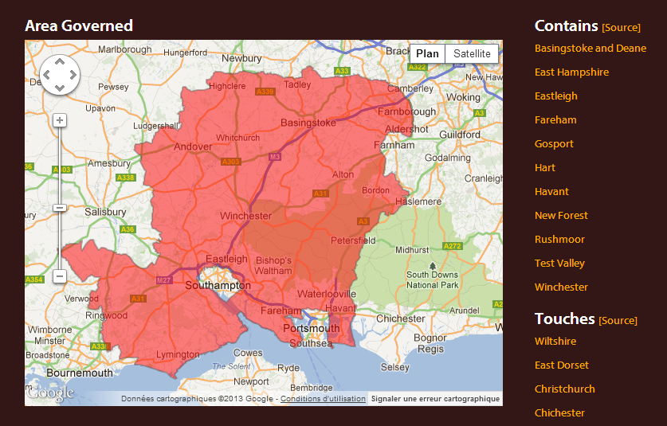
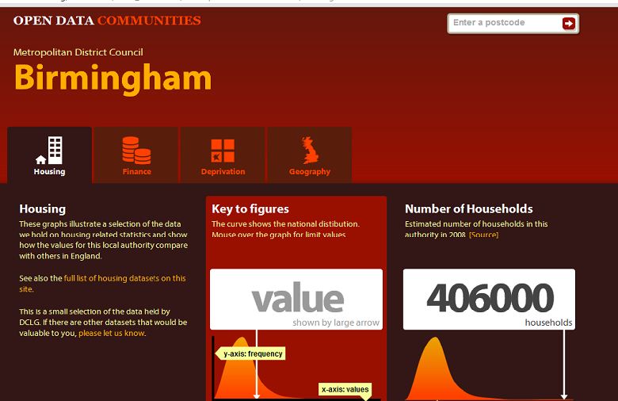
Describing an Application: Opendatacom
Scope/Domain: Department for Communities and Local Government, datasets access
Description: visualize available datasets (finance, housing, deprivation, geography) by authorities or postcode.
On the dashboard, it provides graphs showing the national distribution of a district and how the values for this local authority compare with others in England.
Supported Platform: Web
URL Policy: http://{domain}/id/{...} with redirection to the corresponding document at: http://{domain}/doc/{...}.
Hampshire County Council is: http://opendatacommunities.org/id/county-council/hampshire
Data Sources: 36 datasets from DCLG, Administrative Geography and Postcodes from Ordnance Survey.
Type of View: Graph, Map views.
Visualization Tools: google visualization API, raphael.js
License: Open Government license [OGL]
Business Value: Non commercial

Slide 54
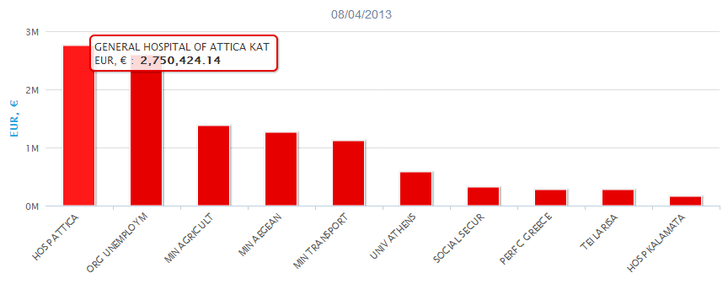
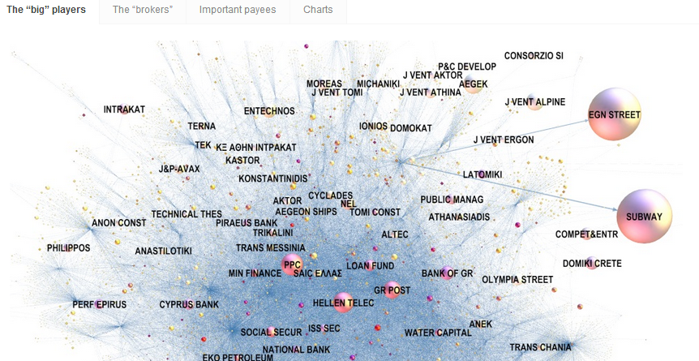
Describing an Application: publicspending.gr
Scope/Domain: Public spending, Government
Description The application helps visualizing the most characteristic facts of the Greek public spending, interconnected to foreign expenditure and other data.
Supported Platform: Web
URL Policy: http://publicspending.medialab.ntua.gr/en/{NAME-CHART}.php. E.g: http://publicspending.medialab.ntua.gr/en/toppayersday.php
Data Sources: http://opendata.diavgeia.gov.fr; Greek Tax data (TAXIS).
Type of View: Bubble tree, column and bar charts
Visualization Tools: HighchartsJS, Bubble TreeJS JqueryJS ; RaphaelJS
License: Open Government license [OGL]
Business Value: Non commercial ( Free)

Slide 55
A vocab to describe Apps
dctype:Software
Prefixes:
@prefix dct: <http://purl.org/dc/terms/>.
@prefix dcat: <http://www.w3.org/ns/dcat#>.
@prefix dctype: <http://purl.org/dc/dcmitype/>.
@prefix org: <http://www.w3.org/ns/org#>.
@prefix dvia: <http://data.eurecom.fr/ontology/dvia#>.
dvia: Application
dvia: Platform
org:Organization
dct:title
dvia:description
dvia:keyword
dvia:url
dct:creator
dvia:businessValue
dvia:scope
dvia:view
dct:title
dvia:system
dvia:preferredNavigator
dvia:alternativeNavigator
dvia:designBy
dvia:platform
dvia:usesTool
dvia:consumes
dcat: Dataset
dvia: VisualTool
dct: title
dcat: accessURL
dct:references
dcat: keyword
dct:title
dct:description
dvia:accessUrl
dvia: downloadUrl

Slide 56

Conclusion and Future Work
Use and evaluate DVIA
Scrap and reconcile data from apps contests: see the upcoming catalog from Apps4Europe
Interconnect application descriptions that use heterogeneous datasets in order to reuse tools and views
Detect patterns for visualization
Inspect datasets to detect top categories:
persons, organizations, events, geo, time series, statistics, etc.
Inspect “sameAs” links between datasets:
focus visualization on properties attached to interconnected data objects
Generate automatically visualizations based on patterns
Notes:
*The Apps4Europe project, recently release a big catalog of all Apps in Europe and the goal now is to make some script for populating DVIA.
* Towards Linked Open Visualizations (LOVIZ) catalog

Slide 57
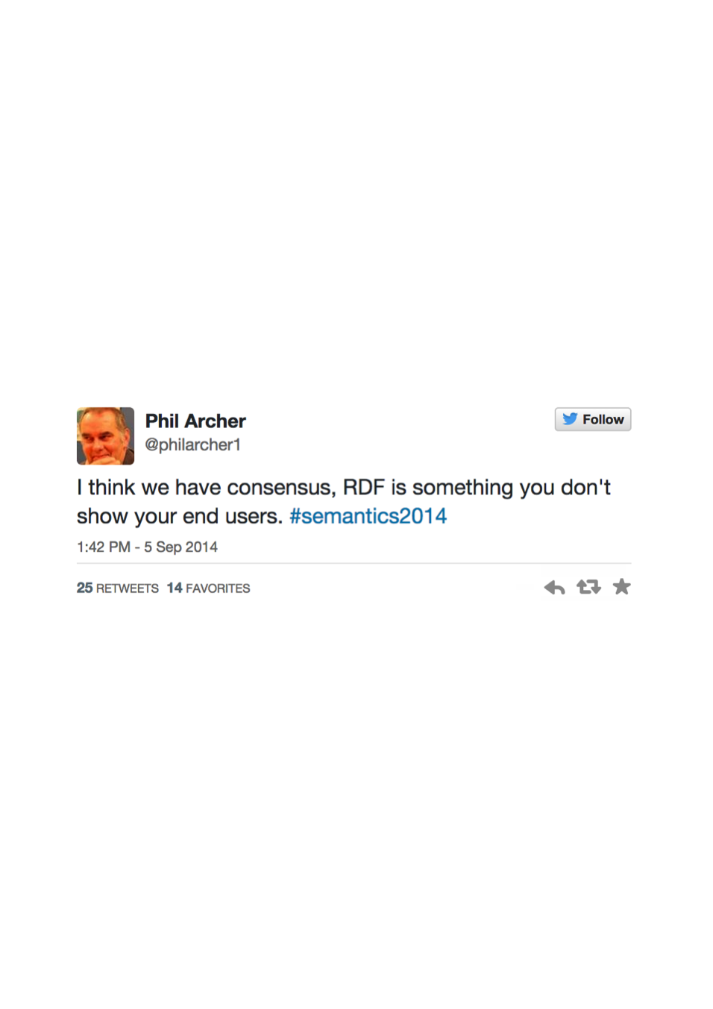

Challenges
“Don’t ask what you can do for
the Semantic Web; ask what
The Semantic Web can do for you!” (D. Karger, MIT CSAIL) –
1- How to build bridge to fill the gap between traditional
InfoVis tools and Semantic Web technologies
2- How can Semantic Web help in visualization?

Slide 58
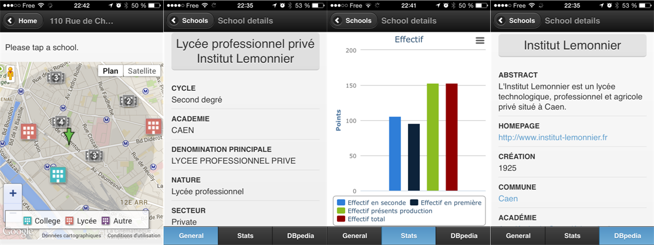
A Journey of a Web Application developer
Scenario 1:
Known Datasets, Known vocabularies → Specific SPARQL queries
Visualizations: dataset specific
Example
Datasets on schools in France
Vocabularies: geo vocab, data cube, geometrie,
Application: PerfectSchool

Slide 59
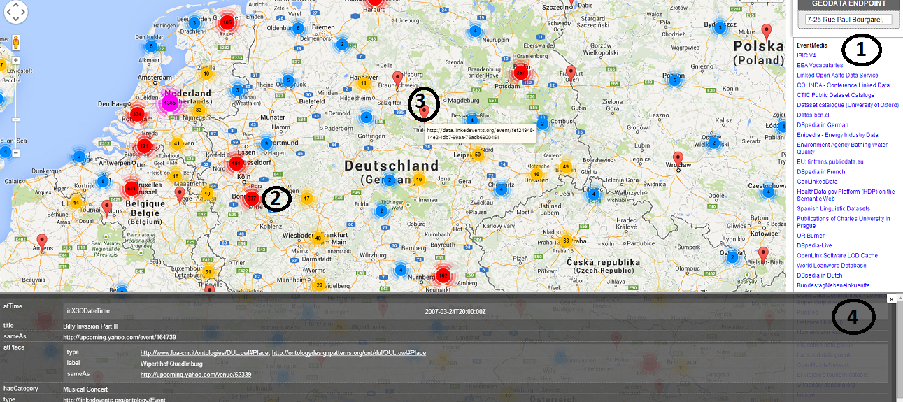
A Journey of a Web Application developer
Scenario 2:
Unknown Datasets, Known domains, so domain-specific SPARQL queries
Visualizations: domain specific
Example
Endpoints of geodatasets
Domain: geospatial
Application: GeoRDFviz

Slide 60

A Journey of a Web Application developer
Scenario 3:
Unknown Datasets, Unknown domains, so generic SPARQL queries
Visualizations: adapted to domains specific
Example
Any endpoints
Multiple domains: geodata, statistics, persons, cross-domains, etc..
Application: ?????
Related work on configuring Semantic Web widgets by data mapping. [1]
Application: Efficient search for Semantic News demonstrator
in Cultural Heritage Dataset
Tool: ClioPatria
…but “method not apply to create
interfaces on top of arbitrary
SPARLQ endpoints”
[1] Hildebrand, Michiel, and Jacco Van Ossenbruggen. "Configuring semantic web interfaces by data mapping."
Visual Interfaces to the Social and the Semantic Web (VISSW 2009) 443 (2009): 96.

Slide 61
Our Proposal
Linked Data
Vizualization
Wizard (LDVizWiz)

Slide 62
Requirements of LDVizWiz (LDViz-”Wise”)
Predefined categories associated to visual elements
Build on top of RDF standards
e.g., SPARQL queries ; Semantic Web technologies
Reuse existing Visualization libraries
e.g., Google Maps, Google Charts, D3.js, etc.
Input: Datasets published as LOD
Reuse Information Visualization Taxonomy
Target to non “RDF/SPARQL speakers”

Slide 63
Mapping Categories and vocabularies
Geographic information
geo: vocab, schema:Place, etc.
Temporal information
Time, interval ontologies
Event information
lode, event, sport, etc..
Agent/Person
foaf:Person/foaf:Agent
Organization information
ORG vocabulary, foaf:Organization
Statistics information
Data cube, SDMX model
Knowledge information
Schemas, classifications using SKOS vocabulary

Slide 64
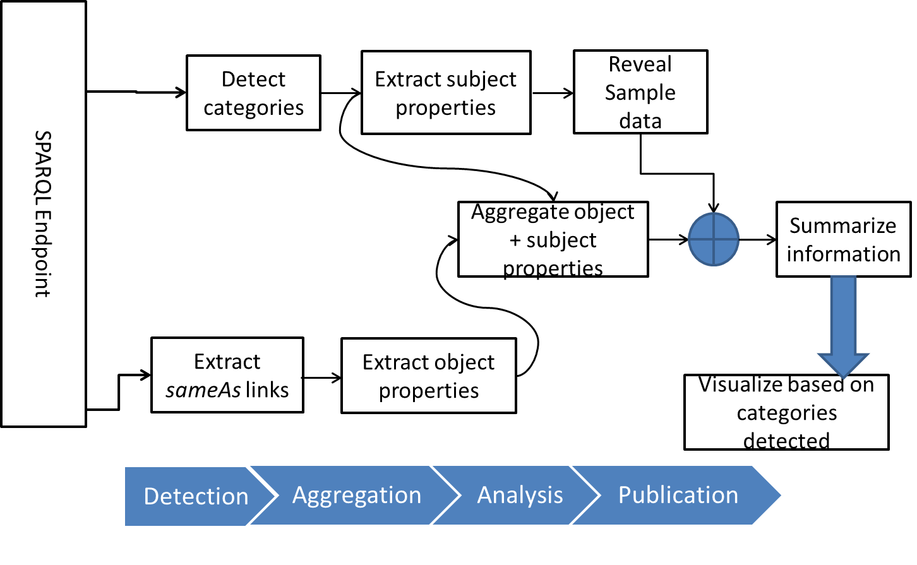
LDVizWiz Workflow

Slide 65
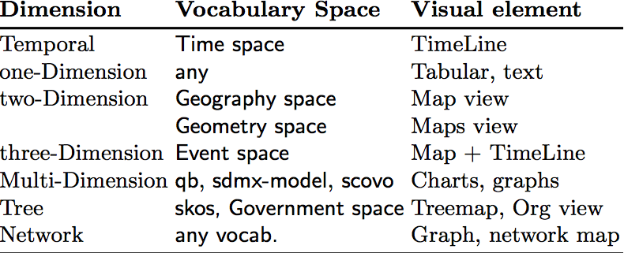
Step 1: Categories detection
Detection of main categories in datasets
ASK SPARQL queries on predefined categories
Uses well-known vocabularies in LOV
Unveil main facets of the visualizations
Condition the type of visual elements
Detection

Slide 66
Experiment: Categories Detection
Category | Number | %
GEO DATA | 97 | 21.84%
EVENT DATA | 16 | 3.60%
TIME DATA | 27 | 6.08%
SKOS DATA | 02 | 0.45%
ORG DATA | 48 | 10.81%
PERSON DATA | 59 | 13.28%
STAT DATA | 29 | 6.6%
Applications
Automatic detection of endpoints categories
More “trustable” than human tagging
Map categories detected with “suitable” visual elements for the visualizations (e.g., TimeLine +maps for events data)
444 endpoints (*) analyzed, 278 good answers (62.61%) using ASK queries.
Few taxonomies in SKOS, many GEO DATA
(*) All the endpoints retrieved from sparqles.org

Slide 67
Step2: Properties Aggregation
Goal: Exploit the “connectors” between graphs
“connectors” are used to enrich a given graph
e.g., owl:sameAs ; rdfs:seeAlso, skos:exactMatch
Retrieve properties from external datasets
So called “enriched properties”
Build candidate properties for visualization
For pop-up menus
For facet browsing
For charts display
Aggregation
Detection

Slide 68
Step3: Publication
Visualization Generator
Recommend the visual elements based on categories
Transform ASK queries to SELECT or CONSTRUCT queries for input to visual library.
Visualization Publisher
Export the description of visualization in RDF
Add metadata for the visualization (charts) and steps used to create it.
e.g., dcat:Dataset, prov:wasDerivedFrom, void:ExampleResource, chart vocabulary
Publication
Aggregation
Detection

Slide 69
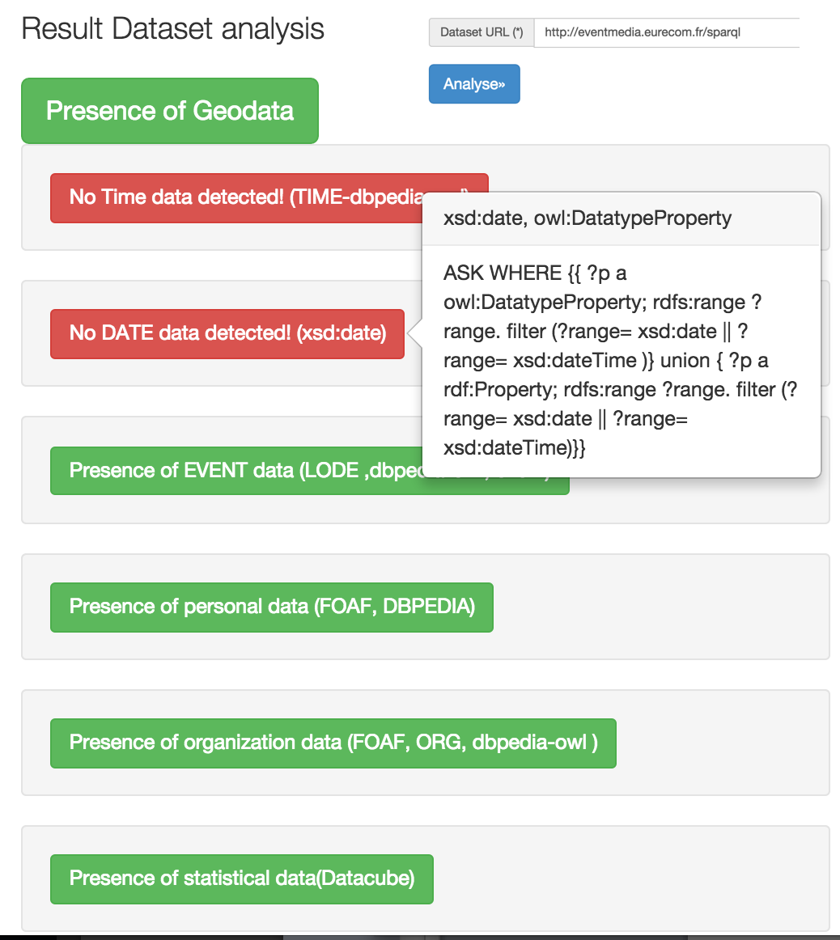
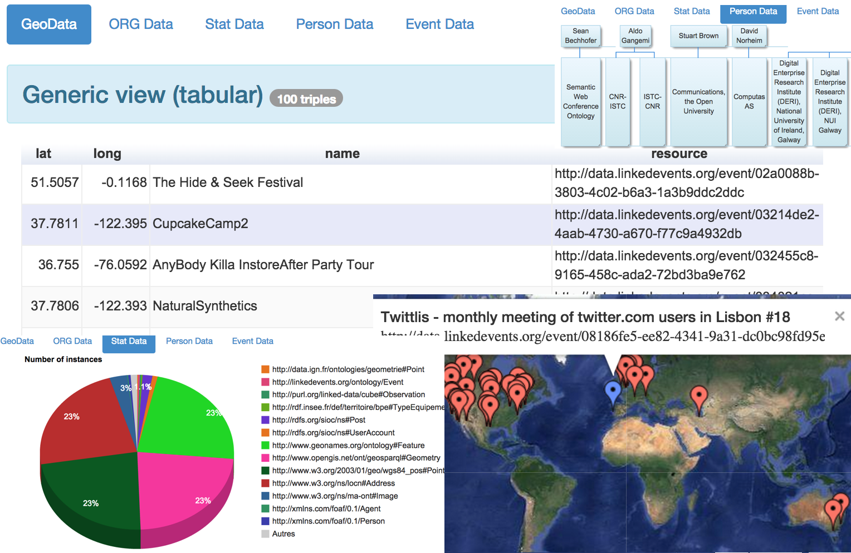
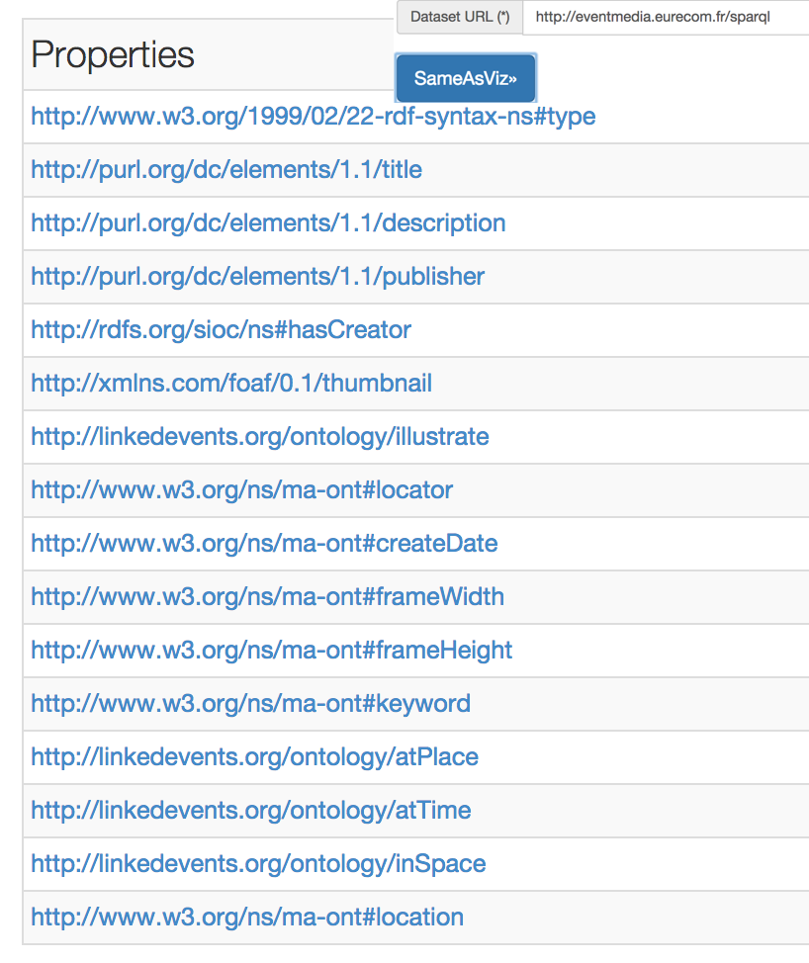
Current Implementation
Javascript light version as “proof-of-concept”
Url: http://semantics.eurecom.fr/datalift/rdfViz/apps/

Slide 70
Part Three
Contribution to Standards

Slide 71
Harmonizing vocabulary Prefixes
Goal: align services against Linked Open Vocabularies to harmonize and manage vocabularies’ namespaces
Motivation
Identify vocabularies using namespace
Catalogs of vocabularies
Services managing vocabularies
Prefix.cc versus LOV
Different policies but same goal
Aligning LOV with Prefix.cc
Towards governance of vocabularies

Slide 72

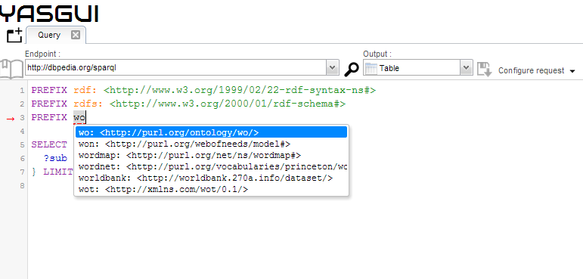
Prefixes lookup headache
PREFIX.CC
What <wo> namespace stands for?
LOV
Notes:
The answers to these Use Cases need to do some screen scraping on different html pages of data portals where the applications are described, sometimes without many information nor description.

Slide 73
QNames and vocabulary namespaces
Usage of namespaces
From XML syntax with xmlns declarations
Use to identify a valid namespace
On the Semantic Web
Extended notion of namespace for other RDF serialization (N3, Turtle)
Some de facto prefixes emerging: rdfs:, foaf:, rdf: owl:
SPARQL endpoints use a list of built-in prefixes not transparent to the developers

Slide 74
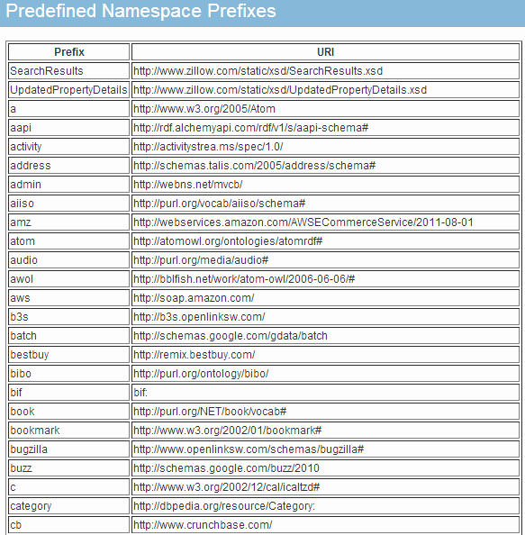
Why if … global use of prefixes
Global namespaces
With good practices to recommend a prefix
Have a more transparent list of built-in prefixes
All the services understand each other with prefixes

Slide 75
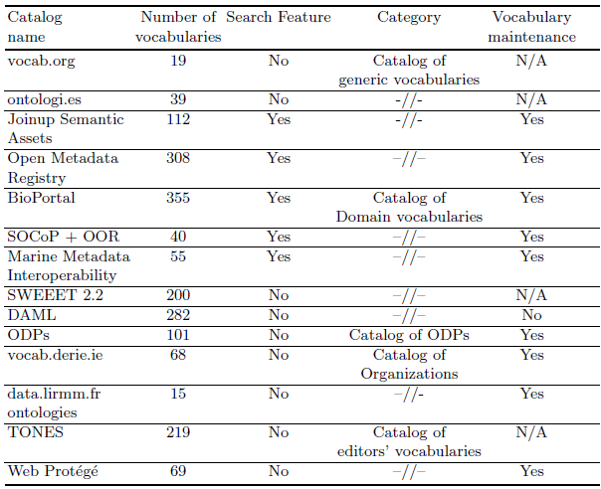
Existing catalogs of vocabularies
Many overlapped of vocabularies among different catalogs

Slide 76



LOV in a Nutshell : http://lov.okfn.org/dataset/lov/
A curated list of vocabularies
More than 450 vocabularies
Each of them described by vocabulary-of-a-friend (voaf)
Provide a dump in .n3 of the different versions of a vocabulary
Some related services
SPARQL endpoint: http://lov.okfn.org/endpoint/lov
Search function: http://lov.okfn.org/dataset/lov/search
An Aggregator endpoint: http://lov.okfn.org/endpoint/lov_aggregator
An intelligent bot agent for updates: http://lov.okfn.org/dataset/lov/bot

Slide 77
LOV DESCRIPTION
CORE FEATURES OF THE FRAMEWORK
Domain | Intended Use | Collection | Gatekeeping | Number of Ontologies | Dynamics | Search metadata | Search within ontology | Search across ontologies | Navigation criteria
General | Promote and facilitate the reuse of vocabularies in the linked data ecosystem. | Submitted by any user via LOV-Suggest tool. | Manual curation and automatic URI validation | 370 | Growing | Yes, with visual depiction | Yes | Keyword-based; structured search (query-based) | Ordered by prefix, namespace, title and visual links navigation
CORE FEATURES OF THE FRAMEWORK
Metrics | Comments and review | Ranking | Web service access | SPARQL endpoint | Content available | Read/Write | Ontology directory | Ontology registry | Application platform
Reuse popularity on the LOD Cloud | N/A - Only by the curators | Metric-based | API | Yes | Ontology metadata, URI | Read | Yes | Yes | Yes
LOV DESCRIPTION WITH THE FRAMEWORK OF [d’Aquin-Noy2012-Survey]

Slide 78

Prefix.cc in a Nutshell: http://prefix.cc
A service to look up namespaces
More than 1200 namespaces registered
Anyone can add prefixes
In case of conflicts, users can vote
Some related services
Namespace lookup API: http://prefix.cc/about/api
Reverse lookup API: http://prefix.cc/reverse

Slide 79
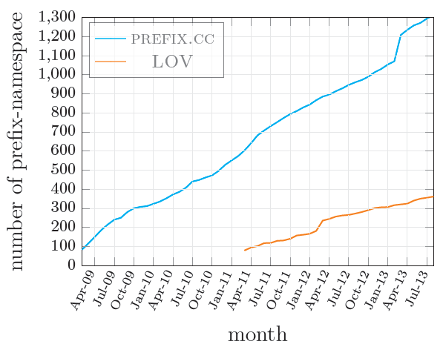
LOV vs PREFIX.CC-Alignment Process
Continuously growth of namespaces registered in prefix.cc.
Clearly view of the results of the harmonization process in the period of March to July, 2013

Slide 80
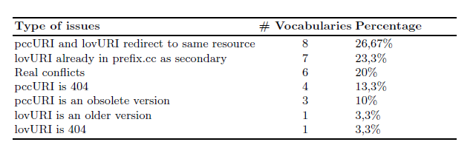
Aligning LOV with Prefix.cc
Dealing with conflicts
Clashes: same prefix but different URIs
Disagreements on preferred namespace
Actions in case of disagreement
Generally 4 types of actions
Important: social aspect to contact the editors of the vocabularies

Slide 81
Alignment Results
Method
Federated query in SPARQL 1.1
Jena ARQ command line
Category | Number
lov-able vocabs | 227
Intersect-prefixes | 188
vocabs in LOV | 321
vocabs in prefix.cc | 925
More than 200 prefixes are
vocabularies

Slide 82
Conclusion
We have presented LD Wizard to generate Visualizations
Based on RDF standards and SemWeb Technologies
Target to lay-users for graph analysis
Composed of 3 main steps: category detections, property aggregation and visualization publication
A Javascript implementation shows the usefulness of the approach
Notes:
*The Apps4Europe project, recently release a big catalog of all Apps in Europe and the goal now is to make some script for populating DVIA.
* Towards Linked Open Visualizations (LOVIZ) catalog

Slide 83
Conclusion
We have presented a way to manage prefixes
By analyzing vocabularies in LOV and prefix.cc
By providing mechanism of aligning two services dealing with vocabulary prefixes
Prefixes management
Provide a unique interface for submission of namespaces and prefixes to both services
Publish a list of common recommended prefixes
Foster and support current effort towards a more sustainable governance of vocabularies.
Notes:
*The Apps4Europe project, recently release a big catalog of all Apps in Europe and the goal now is to make some script for populating DVIA.
* Towards Linked Open Visualizations (LOVIZ) catalog

Slide 84
Future Work
Managing Data updates and versioning
Versioning: integrate Memento protocol?
Spatio-temporal evolution
Multiple representation: need for metadata?
Level of detail
Geometry modeling rules and reasoning
Tracking Provenance of geodata
To ensure quality of published dataset
To ensure trust from application consumers
Notes:
*The Apps4Europe project, recently release a big catalog of all Apps in Europe and the goal now is to make some script for populating DVIA.
* Towards Linked Open Visualizations (LOVIZ) catalog

Slide 85
Future Work
Visualizations
Extend categories and vocabularies for detection
Add more libraries for visual elements in visualizations
Provide templates for generating “mash-ups” to combine domains
Integrate a mash-up widget generator
Investigate the “importance” of a category in dataset
Provide a user evaluation
Metadata management
Publish a list of common recommended prefixes
Foster and support current effort towards a more sustainable governance of vocabularies.
Notes:
*The Apps4Europe project, recently release a big catalog of all Apps in Europe and the goal now is to make some script for populating DVIA.
* Towards Linked Open Visualizations (LOVIZ) catalog

Slide 86
Publications
Pierre-Yves Vandenbussche, G.A. Atemezing, Maria Poveda, Bernard Vatant: Linked Open Vocabularies (LOV): a gateway to reusable semantic vocabularies on the Web. Semantic Web Journal, under review, 2015.
G.A. Atemezing, Raphael Troncy: Modeling visualization tools and applications on the Web. Semantic Web Journal, under review, 2015.
G.A. Atemezing et al.: Transforming meteorological data into linked data. In Semantic Web journal, Special Issue on Linked Dataset descriptions, 2012. IOS Press.
Guido Governatori, Ho-Pun Lam, Antonino Rotolo, Serena Villata, G.A. Atemezing and Fabien Gandon: LIVE: a Tool for Checking Licenses Compatibility between Vocabularies and Data.(ISWC 2014, Demo Track)
G.A. Atemezing and Raphael Troncy: Information content based ranking metric for linked open vocabularies. (SEMANTICS 2014)
Ahmad Assaf, G.A. Atemezing, Raphael Troncy and Elena Cabrio: What are the important properties of an entity? Comparing users and knowledge graph point of view. In 11th Extended Semantic Web Conference (Demo Track, ESWC 2014)
Notes:
*The Apps4Europe project, recently release a big catalog of all Apps in Europe and the goal now is to make some script for populating DVIA.
* Towards Linked Open Visualizations (LOVIZ) catalog

Slide 87
Publications
Francois Scharffe, G.A Atemezing, Raphael Troncy, Fabien Gandon, Serena Villata, Bénédicte Bucher, Faycal Hamdi, Laurent Bihanic, Gabriel Kepeklian, Franck Cotton, Jerome Euzenat, Zhengjie Fan, Pierre-Yves Vandenbussche and Bernard Vatant: Enabling linked-data publication with the datalift platform. (AAAI, W10:Semantic Cities, 2012)
G.A. Atemezing and Raphael Troncy: Vers une meilleure interopérabilité des donneés geographiques francaises sur le Web de donneés. (IC 2012).
Houda Khrouf, G.A. Atemezing, Thomas Steiner, Giuseppe Rizzo and Raphael Troncy: Confomaton: A conference enhancer with social media from the cloud. (ESWC 2012, Demo Track)
Bernadette Hyland, G.A. Atemezing and Boris Villazón-Terrazas (editors): Best Practices for Publishing Linked Data. W3C Working Group Note pub- lished on January 9, 2014. URL: http://www.w3.org/TR/ld-bp/
Bernadette Hyland, G.A Atemezing, Michael Pendleton, Biplav Srivastava (editors): Linked Data Glossary. W3C Working Group Note published on June 27, 2013. URL: www.w3.org/TR/ld-glossary/
Notes:
*The Apps4Europe project, recently release a big catalog of all Apps in Europe and the goal now is to make some script for populating DVIA.
* Towards Linked Open Visualizations (LOVIZ) catalog

Slide 88

Thank you for your attention!

Slide 89
Publishing and Consuming Government Linked Data on the Semantic Web
Ghislain Auguste Atemezing
Multimedia Department, Eurecom
Supervisor:
Dr. Raphaël Troncy, MM Department, Eurecom

